Slide 1
A Unified Cognitive Model of Visual Filling-In Based on an Emergic Network Architecture
Notes:
Presentation look and feel adapted from the “Brain” Microsoft Office Online template.
Presentation complements the thesis.

Slide 2
Approaches to Decomposition
Isomorphic Functions
Emergic Functions
P1
P2
Pp
P1
P2
Pp
…
Phenomena/Behaviour
…
M1
M2
Mm
M1
F1
F2
Ff
…
Functional Models
F1
F2…
Notes:
Slide is a caricature to some extent, but…
Main point is that the resultant decomposition is different and that a new approach is warranted
Moreover, functional decomposition is multi-realizable. Do we have the right compositions today?

Slide 3
ECM Functional Decomposition
Two parallel & interactive functions:
Maintain Information Coherence
  When old information in a recurrent flow meets new information, compensate for motion so that they “refer” to the same “thing”
Handle Missing Data
  If bottom-up information is missing, fill it in using lateral or top-down flows
  (This is not an isomorphic “filling-in” process)
Notes:
Parallel, interactive and non-hierarchical at this level of analysis
Not traditional functional formulations
Descriptive “filling-in” vs. explanative filling-in.

Slide 4


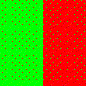
Isomorphic vs. Emergic functions
Emergic filling-in behaviour, but…
No isomorphic functional filling-in
  Due to interactions
  Filling-in over sensory irregularities (absences) but not over stimuli irregularities
Notes:
Functions isomorphic to phenomena, e.g., filling-in function, have trouble when behaviour should not occur
They are the wrong functional decompositions
Filling-in should remain descriptive and not explanative
Our explanative functions are finer grained and not explicitly about filling-in
Filling-in behaviour emerges when required

Slide 5
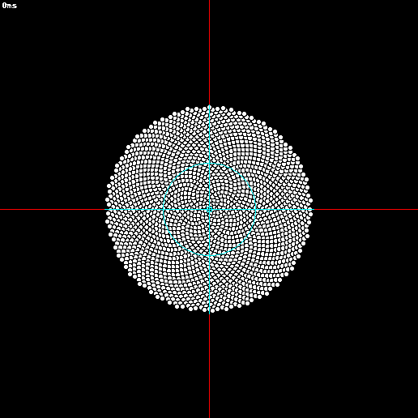
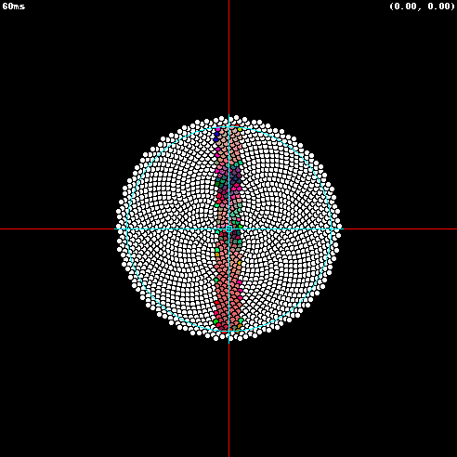
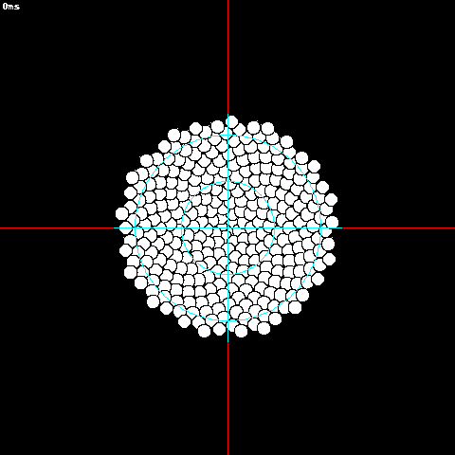
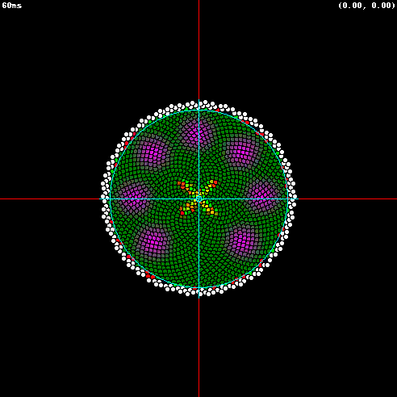
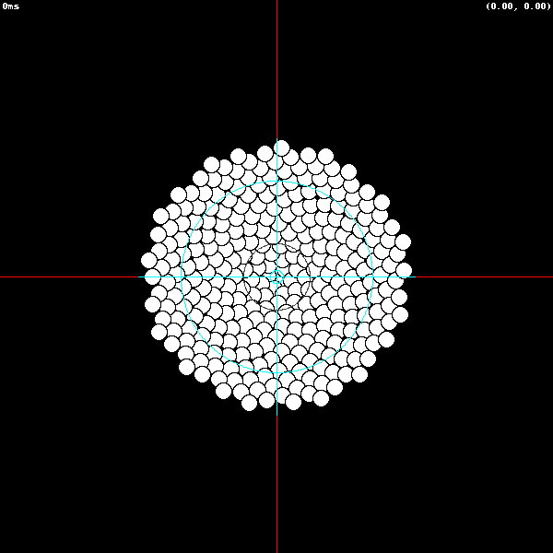
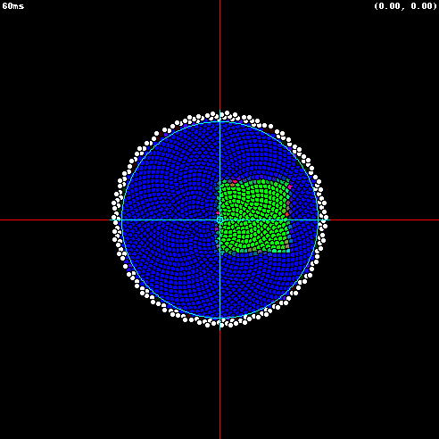
Thesis shows: 2 functions →
8 phenomena (Unified)
Chapters: 2-5 |  | Appendices: A-D
2: Homogeneity
3: Transsaccadic
A: Anorthoscopic
B: Foveal Blue Scotoma
4: Brief
5: Blind-spot
C: Blinks
D: Imagination
Notes:
Each of these lines of inquiry are ordinarily researched independently
Each has its own rich phenomenology
Thesis is organized in a phenomena first manner so this presentation will not go into those details
This presentation is in a model first manner, how it differs from classical approaches, and its strengths

Slide 6
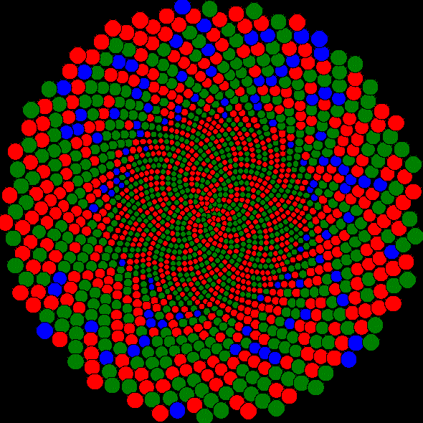
ECM Structural Overview
Ecological validity
  Detailed retina
  Motion
Biological plausibility
  Multiscale hierarchy
  Massive Recurrence
Hierarchy
Receptive Field (RF)
Level#3
RF
RF
RF
Level#2
Eye Movement Motor Control
RF
RF
RF
RF
RF
RF
RF
Level#1
Mosaic
(Level#0)
Photoreceptor
Photoreceptor
Photoreceptor
Notes:
The building blocks forming ECM

Slide 7
Classical vs. Emergic Units
Simple Value
Structured Values
Classical Unit
Emergic Unit
Out
Out
D
L
Out
U
U
W1
W3
1
1
1
W2
Highly Recurrent
Notes:
Each Receptive Field (RF) within ECM is an Emergic Unit

Slide 8
Emergic Networks (EN)
Network
Unit 2
Input
Port 3
Output Port 5
Unit 1
Unit 3
Output Port 4
Input
Port 6
Output Port 9
Output Port 1
Software
Input
Port 7
Software
Links
Software
Input
Port 2
Values
Output Port 8
Notes:
These are the structural elements forming a prototypical EN
Network, Units, Ports, Links
Structure of Values
Software
Ecological situation
The only dynamics is the flow of values through the network
Includes ecological engagement through sensors and effectors

Slide 9
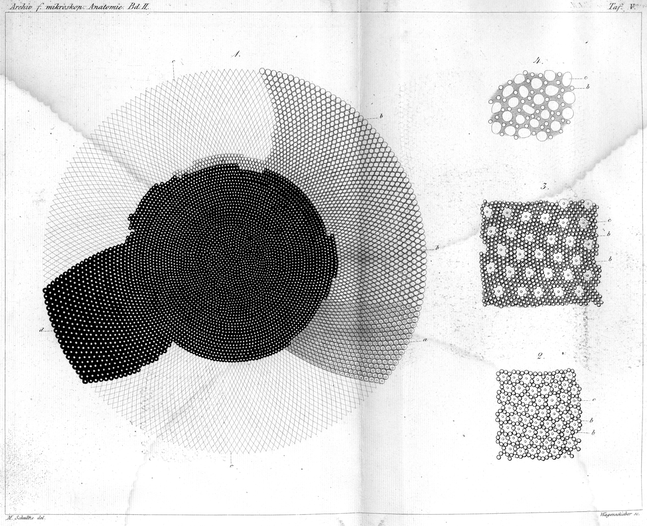
Visual Realism: Biological
(Photoreceptor Topology)
(Schultze, 1866)
ECM
Notes:
Blue-free region
Receptive field sizes that increase with eccentricity
Random cone sensitivities
“Random” cone positions

Slide 10
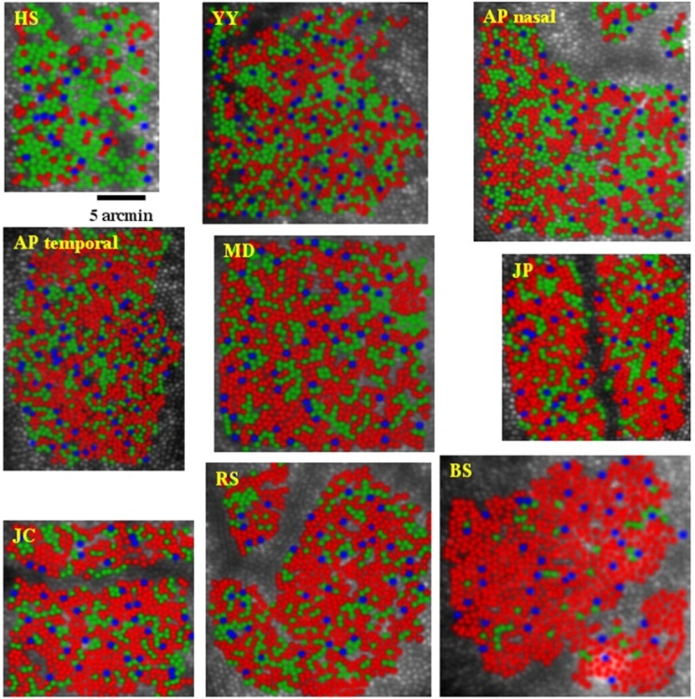
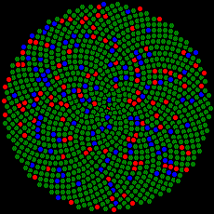
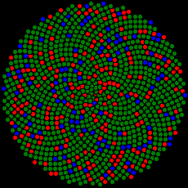
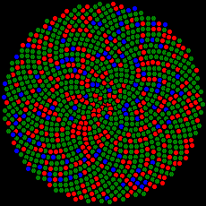
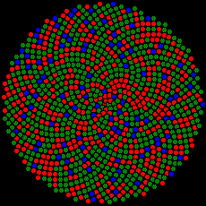
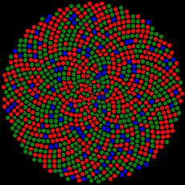
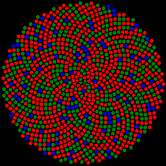
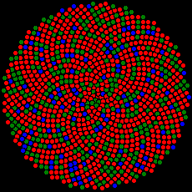
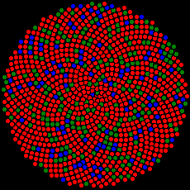
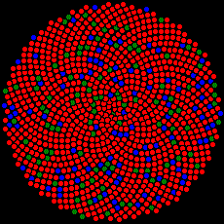
Visual Realism: Biological (Photoreceptor Variance)
(Hofer et al, 2005)
ECM
Notes:
Explain colour homogeneity and linearity

Slide 11




Visual Realism Overview
$$\left[\begin{matrix}R \\ G \\ B\end{matrix}\right]$$
View
Virtual eye “sees” the screen
Virtual eye jitters
Virtual eye saccades
Virtual eye blinks
Virtual eye has blind spot
Virtual eye has blue scotoma
Objects move
Object
Blinks
$$\left[\begin{matrix}L \\ M \\ S\end{matrix}\right]$$
Person
Notes:
Non-representational interaction with the environment
Biological sensory system

Slide 12
Handle Missing Data Function
This cognitive function is simple
  If I don’t have a bottom-up value, e.g., blinks
    use lateral value
  If I still don’t have a value,
    use top-down value
  Send out my value
Note: Three flows despite
single output as value
directed up, down & laterally
Emergic
Computational
Unit
Out
D
L
U
Notes:
Lateral is “Memory” that can be split/joined by shifting
Data could be missing due to: heterogeneity; damage; eye blinks; occlusions; beyond the retina; etc.

Slide 13

Maintain Information Coherence
Function
This cognitive function is complex:
  Distribute motor plans in advance
  Shift coordinates to maintain infocentric reference frame
  Broadcast information locally (~Local Area Network)
  Tag information (~Internet protocol)
  Interpolative summation
Receptive Field Layer 3
Receptive Field Layer 2
Receptive Field Layer 1
Stimulus

Slide 14
Distribute Motor Plans (Shifts)
Planning System
Legend:
↑U: Up
↓D: Down
Input
Output
IDShift
OUShift
Planner
ODShift
IUShift
Pyramid
IDShift
OUShift
IDShift
OUShift
Distributor
RF Layer 3
ODShift
IUShift
ODShift
IUShift
IDShift
OUShift
Distributor
IDShift
OUShift
IDShift
OUShift
Compensate for eye motion
Allow the shifting of sensory information
RF Layer 2
RF Layer 2
ODShift
IUShift
ODShift
IUShift
ODShift
IUShift
IDShift
OUShift
Distributor
IDShift
OUShif
RF 1
IDShift
OUShif
IDShift
OUShif
RF 1
RF 1
IDShift
OUShif
RF 1
ODShift
IUShift
ODShif
2
IUShift
ODShif
2
IUShift
ODShif
2
IUShift
ODShif
IUShift
2
IDShift
OUShift
Executor
ODShift
IUShift
Photoreceptors (Level 0)

Slide 15
Broadcast Locally
Like a LAN
  Cognitive fan-out parameters
Up needs no broadcast (better precision)
Emergic
Computational
Unit
Out
D
Emergic
Computational
Unit
Out
D
L
L
U
U
Notes:
Lateral is “Memory” that can be split/joined by shifting

Slide 16
Tag Spatial Information in Structured Values
ValueXY((x,y,v,w)…)
  x: the spatiotopic x-coordinate of this sample value
  y: the spatiotopic y-coordinate of this sample value
  v: the L, M or S colour value of this sample from 0 to 255
  w: the weight assigned to this sample value
  …: repeatable, in which case this emergic value represents the descriptive statistics for all the samples weighted accordingly
Internal Representation (for L, M & S)
  n: the number of samples = ∑1 n += 1
  sw: sum of sample weights = ∑w_{n} sw += w
  swx: weighted sum of X coordinates = ∑w_{n}x_{n} swx += wx
  swy: weighted sum of Y coordinates = ∑w_{n}y_{n} swy += wy
  swv: weighted sum of colour values = ∑w_{n}v_{n} swv += wv
  swxx: weighted sum of X coordinate squared = ∑w_{n}x_{n}² swxx += wxx
  swxy: weighted sum of X coordinate multiplied by Y’s = ∑w_{n}x_{n}y_{n} swxy += wxy
  swyy: weighted sum of Y coordinate squared = ∑w_{n}y_{n}² swyy += wyy
  swvv: weighted sum of colour value squared = ∑w_{n}v_{n}² swvv += wvv
Mean(x) = swx/sw; variance(x) = (swxx – swx²/sw)/sw; sd(x)=√variance(x)
Tag
Notes:
Note: the spiking output of neurons alone or in a group does have statistical properties
The SD is used for calculating spatial overlap between shifting values and static RFs

Slide 17
Interpolation but no Extrapolation
(No Filling-In à la diffusion)
v=50±22.4
x=5.5±3.1
3
v=30±10.0
x=3±2.2
v=70±10.0
x=8±1.4
Border Processing
2
RF Level
v=20±0.0
x=1±1.0
v=?
x=?
v=40±0.0
x=5±1.0
v=60±0.0
x=7±1.0
v=80±0.0
x=9±1.0
v=?
x=?
1
I
E
0
1
2
3
4
5
6
7
8
9
10
11
12
Eccentricity of S (Blue) cone channel in minutes of arc
Showing the mean of each RF value ± 1 standard deviation
Notes:
Gives border/edge processing without specialized neural circuitry

Slide 18
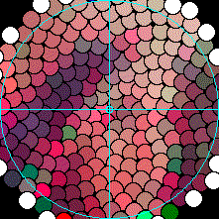
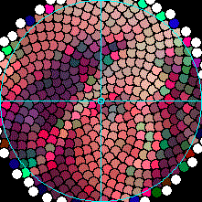
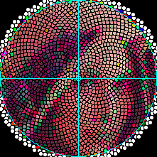
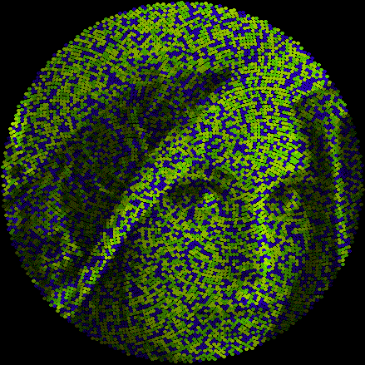
Emergic Cognitive Model (ECM)
Motor
Planning
Legend:
Information Coherence Function
Shift → Shift Distribute Shift Top-Down
Shift → Shift Distribute Shift Bottom-Up
Flowcentric
Units: retinotopic (but delayed)
Values: ~spatiotopic (despite flowing through units)
Spatiotemporal Summation
Sum → Sum Bottom-Up (RGB)
Handle Missing Data Function
Sum → Sum Lateral/Shift Memory (RGB)
Sum → Sum Top-Down Summary (RGB)
Shift
Shift
Shift
Shift
Shift
Shift
Planner
Shift
Shift
Receptive Field Hierarchy
Shift
Shift
Distributor#3
Shift
Shift
Sum
Sum
RF Layer 3
Shift
Shift
Shift
Shift
Sum
Sum
Shift
Shift
Distributor#2
Shift
Shift
Sum
Sum
Shift
Shift
Sum
Sum
RF Layer 2#1
RF Layer 2#2
Shift
Shift
Shift
Shift
Sum
Sum
Shift
Shift
Sum
Sum
Shift
Shift
Distributor#1
Shift
Shift
Sum
Sum
Shift
Shift
Sum
Sum
Shift
Shift
Sum
Sum
Shift
Shift
Sum
Sum
RF Layer 1#4
RF Layer 1#1
RF Layer 1#2
RF Layer 1#3
Shift
Shift
Shift
Shift
Sum
Sum
Shift
Shift
Sum
Sum
Shift
Shift
Sum
Sum
Shift
Shift
Sum
Sum
2
2
2
2
Shift
Shift
Executor
Shift
Shift
Photoreceptors - heterogeneous
Notes:
Each emergic unit has two independent yet interacting parts that lead to emergence
Four ports (2 in, 2 out) on the left hand side of each RF for shifting purposes
Four ports (3 in, 1 out) on the right hand side of each RF for surface LMS colours (*3)

Slide 19
Image Stability
Retinotopic
  Varies with eye motion, E.g., photoreceptors
Spatiotopic: neurocentric
  Invariant to motion
  “Paints a stable image onto dedicated neurons”
  Most commonly sought out, but not found
Spatiotopic: flowcentric
  Invariant to motion
  Maintains coherence among moving flows of information
  Values maintain spatiotopic tags
“Paints a stable image onto flow”
Notes:
Possible mechanisms and conceptualizations ought to influence how one measures for image stability.
Flowcentric suggests an alternative measurement regime and coordinate system
Compatible with RF remapping phenomenology
As all our flows interact coherently, images remain stable within the flow
Suggests the flow as a locus of consciousness

Slide 20
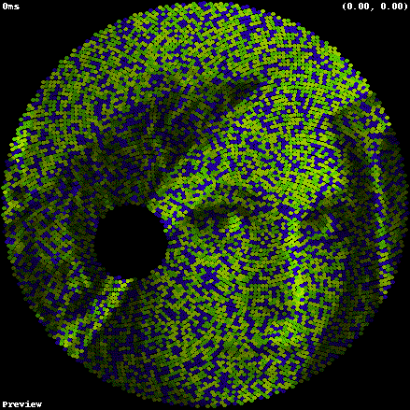
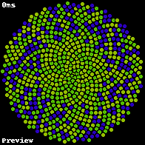
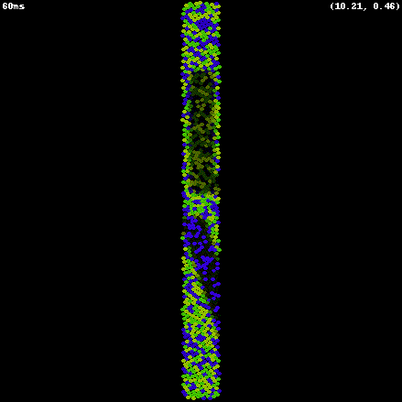
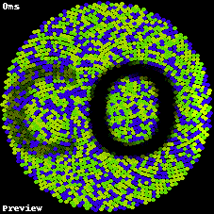
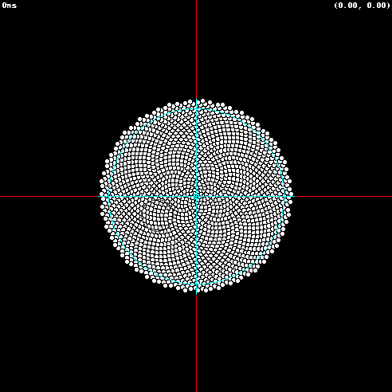
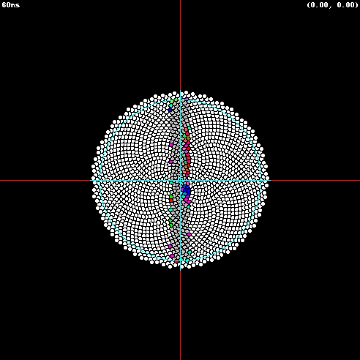
Handling motion
→emergic filling-in (for free)
Temporal vs. spatial mechanisms
  Appears spatial under neurocentric analysis, but
  Actually temporal under flowcentric analysis (cut & paste, e.g., “mpeg vs. jpeg”)
Masking for free
Instantaneous Filling-In

Slide 21
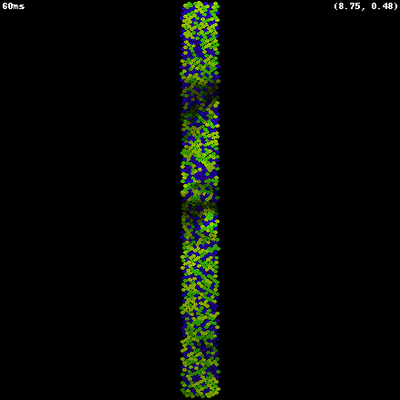
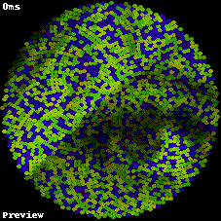
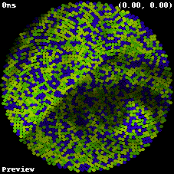
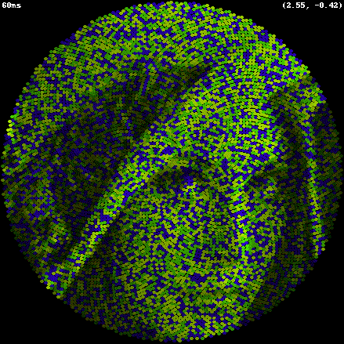

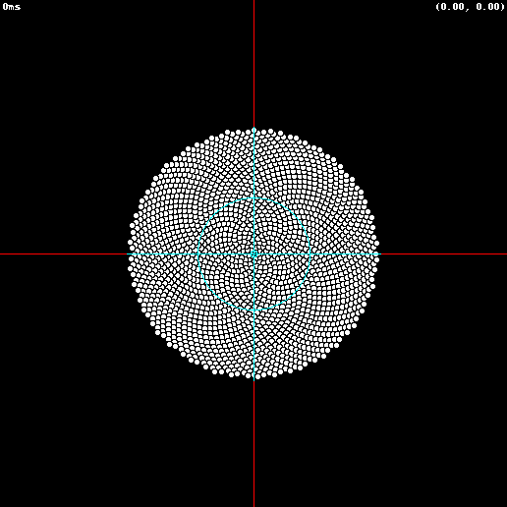
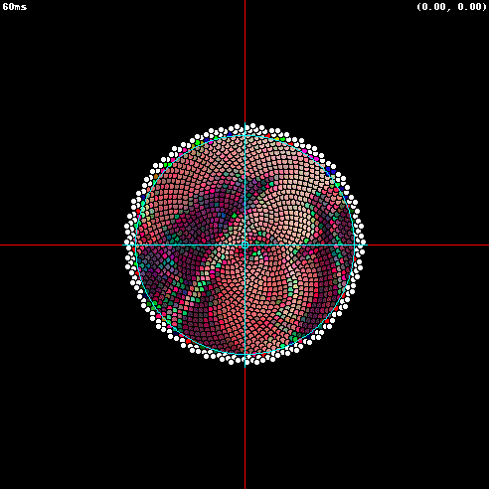
Minimal Blur
Dissipation
No Blur
Open 32
Open 32
Open 5 Closed 3
Open 1 Closed 31
Open 1 Closed 2
Notes:
The entire Emergic Network is synchronous and runs on small time increments called ticks, nominally 10ms each.
These are made small enough to simulate an asynchronous dynamic system
Eyes in third column remain open for 50ms every 80ms.

Slide 22
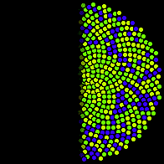

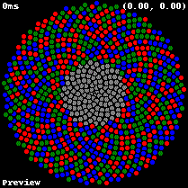
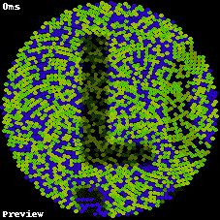

Border & edge detection and completion
Most systems have dedicated neural circuitry for border and edge detection and completion
  Comes for free
Physical arrangement of RFs less important
Temporal vs. spatial edge detection
Notes:
Borders are “respected” but not explicitly completed

Slide 23
Future Work
Connecting model to dendritic processing
Handling object motion
Attention

Slide 24
End of Presentation

Slide 25
Backup

Slide 26
Statistical Based Routing/Summing
A
r=255±0.0 (n=8)
g=? (n=0)
b=? (n=0)
A: Four RFs perfectly aligned with coloured stimuli
B: Eye shifts right by ½ RF width
C: New RF values by statistical lateral shifting
Note: Colour averaged over space, but LM S extents often remain
Dendritic processing
r=127±0.0 (n=2)
g=127±0.0 (n=2)
b=127±0.0 (n=2)
r=? (n=0)
g=? (n=0)
b=255±0.0 (n=4)
r=? (n=0)
g=255±0.0 (n=8)
b=0±0.0 (n=8)
B
r=255±0.0 (n=8)
g=? (n=0)
b=? (n=0)
r=127±0.0 (n=2)
g=127±0.0 (n=2)
b=127±0.0 (n=2)
r=? (n=0)
g=? (n=0)
b=255±0.0 (n=4)
r=? (n=0)
g=255±0.0 (n=8)
b=0±0.0 (n=8)
C
r=255±0.0 (n=4)
g=? (n=0)
b=255±0.0 (n=1)
r=212±60 (n=3)
g=212±60 (n=3)
b=42±60 (n=3)
r=? (n=0)
g=? (n=0)
b=255±0.0 (n=2)
r=? (n=0)
g=255±0.0 (n=4)
b=51±102 (n=5)
Notes:
For top-most RF, ½ Red + ¼ blue overlap → lilac

Slide 27
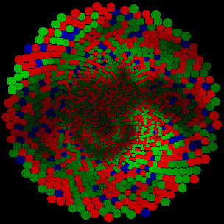
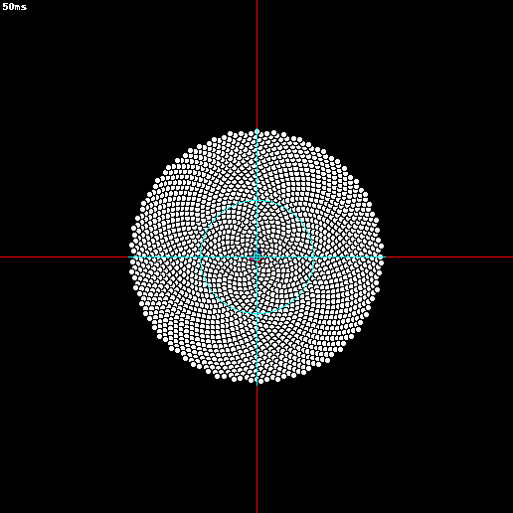
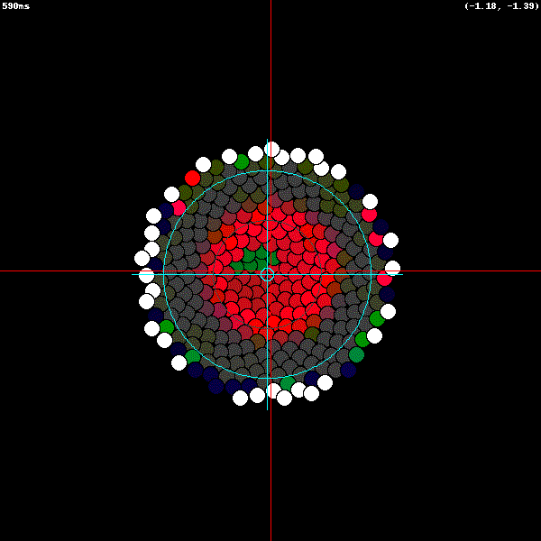
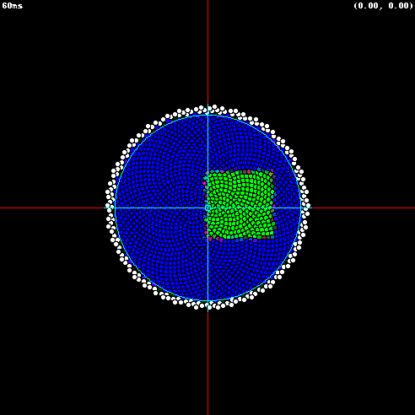


Modelling Contributions
Emergic Networks (EN)
  1) Model of process metaphysics (EM)
  Also primary epistemic contribution
  http://emergic.upwize.com/?page_id=6
Emergic Cognitive Model (ECM)
  2) Detailed model of human retina
  under motion, blinks, scotomas, etc.
  3) Unified model of visual “filling-in”
  phenomenology
    Primary ontological contribution
Emergic Simulation System (ESS)
  4) Model agent/environment interactions
Rabbit * Fox
1
1
- β
+ δ
Rabbit +=
Fox +=
+α
- γ

Slide 28
Bottom-up is not primary
Also examples of “perfect” memories (no diffusion)
Lateral Flow → memory
Top-Down Flow → Generative Memory
Notes:
Top-down is often considered as “merely” modulatory
Surprisingly, there are typically more top-down (efferent/feedback) connections than bottom-up
Memory is normally considered within a neuron, or via interlayer resonance
All flows are equally important functionally

